Slide 1
RatingRefiner
By: Venkat, Scotty, Andrew, and Eric

Slide 2

Topic
Our Goal: Create a machine model that can evaluate customer reviews on products and deliver an overarching and unbiased review.
Features:
- Learn from real customer reviews
- Detect and remove spam
- Able to return a summarizing review about a specific product
- Specific focus on camera-related products
Why: Interested in the idea of being able to collect the best possible review and summary of products based on thousands of word-based reviews, not just a summation of stars in a rating. We wanted to make a tool that can significantly help a consumer’s buying journey.

Slide 3
Data
Name: Amazon US Customer Reviews Dataset
- Very large dataset that holds millions of reviews across over 20 different product categories
Source: Kaggle
Facets:
- 1.8 million lines of customer data for camera products
- Pulled from the official Amazon Reviews Library
- Last updated in 2021

Slide 4
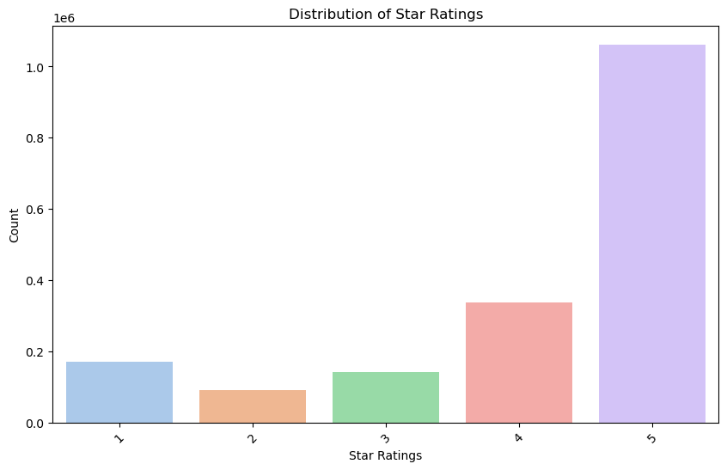
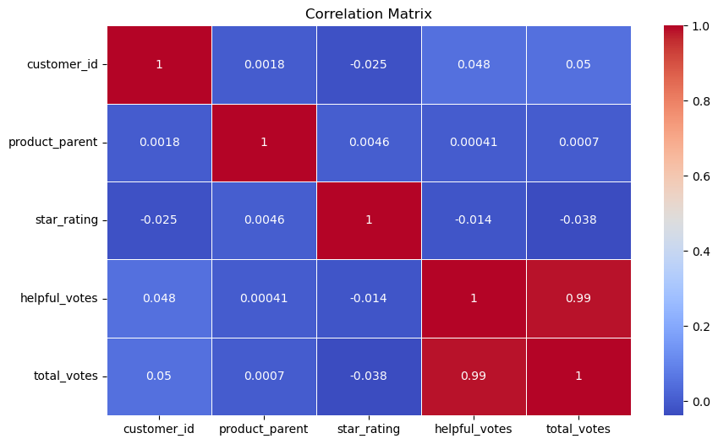
Initial Observations

Slide 5
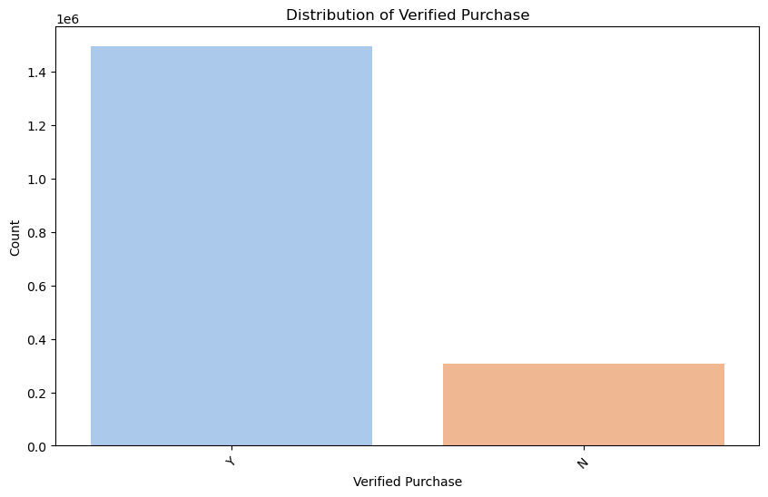
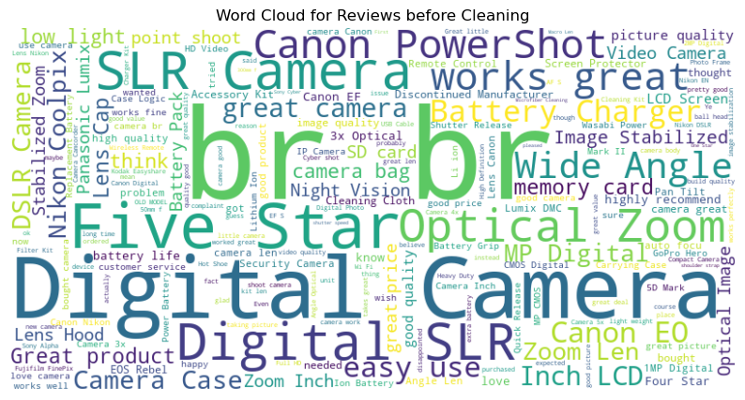
Initial Observations

Slide 6
Preprocessing
Basic Processing
Removal of null values
Condensing of columns
Ex: marketplace, product_parent, review_date
Removal of duplicates (specifically based on review_id)
Random sampling
5 different groupings

Slide 7
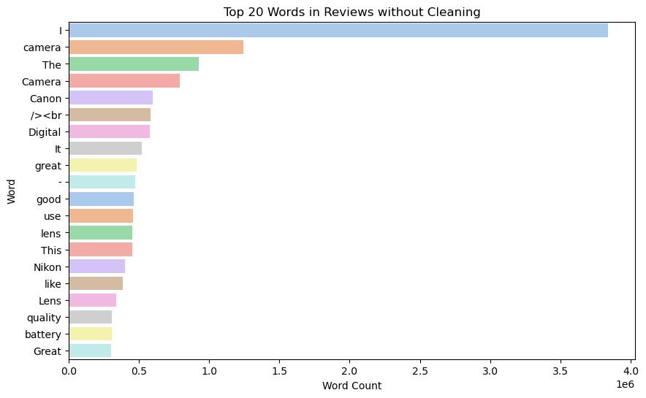
Preprocessing pt.2
Step 2: Model Preparation
Removal of spacing, commas, and other symbols
Removal of ‘stopwords’
Apply tokenizer
TD-IDF versus GPT2

Slide 8
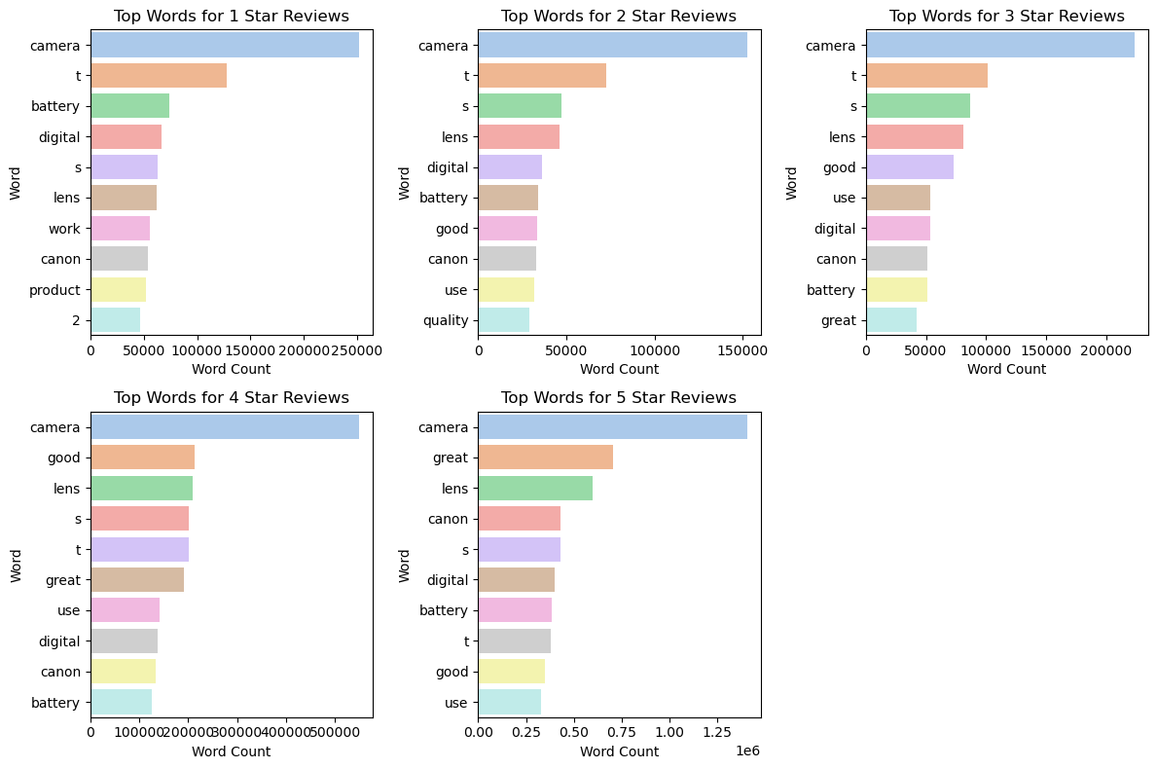
Preprocessing pt.2
Step 2: Model Preparation
Removal of spacing, commas, and other symbols
Removal of ‘stopwords’
Apply tokenizer
TD-IDF versus GPT2

Slide 9
Model Training
Process
Obstacles
- Sentiment Mapping
- Model Training
- Logistic Regression
- RandomForest
- XGBoost
Accuracy Issues
Tokenizer
Switch to TD-IDF
Recall
Shift to 5 groupings

Slide 10
Spam Detector
Process

Slide 11
Spam Detector
Process

Slide 12
Results
Andrews results (picture)

Slide 13
Results
Andrews results (picture)

Slide 14
Future modeling/changes
Expanding to other products, other industries
Ex: restaurants, books
Utilizing other systems and models
More time to research other options to hone in on accuracy
What else is out there?
Potential data change: locational data?

Slide 15
Questions

